Slide 1

HEALTHCARE ANALYSIS PROJECT
BY group – 4
MEMBERS
MD SOHAIL
Preetham chary
Badal Kumar Nath sharma
Rohit Bharat Gaikwad
Prashant Sharma
Akshay Ravindra Patil

Slide 2

KPI’S
Number of Patients across various summaries
Profit Vs Non-Profit Stats
Chain Organizations w.r.t. Total Performance Score as No Score
Dialysis Stations Stats
# of Category Text - As Expected
Average Payment Reduction Rate

Slide 3
Introduction
Healthcare analysis is the process of examining and evaluating data related to healthcare systems, services, policies, and outcomes to gain insights and inform decision-making.
It involves analyzing various aspects of healthcare, including clinical data, financial data, operational data, and patient data, to identify patterns, trends, and correlations that can be used to improve healthcare delivery, patient outcomes, and policy decisions.
The goals of healthcare analysis can vary depending on the context, but generaly include improving patient care, enhancing operational efficiency, optimizing resource allocation, identifying and managing health risks, evaluating interventions and policies, and supporting evidence-based decision- making.
Healthcare analysis plays a critical role in driving evidence-based practice and policy in healthcare, enabling healthcare professionals, policymakers, and administrators to make informed decisions to improve patient outcomes and population health.

Slide 4
IMPLEMRNTATION
Data Cleaning
Used Excel, Power BI, and Tableau to clean the data and ensure its quality.
Removed any duplicate or irrelevant data to make the data set more manageable.
Handled any missing data by using mean imputation for numerical data and mode imputation for categorical data.
Checked for any errors, inconsistencies, or formatting issues and resolved them.

Slide 5
Created visualizations using Excel, Power BI, and Tableau to explore the data and identify patterns and trends.
Used various visualization types, such as scatterplots, histograms, and bar charts, to highlight different aspects of the data Used a combination of static and interactive visualizations to engage the audience and promote understanding of the data.
Used color, size, and other visual cues to highlight key patterns and trends in the data.
Provided an interpretation of each visualization, highlighting key insights and any significant observations.
DATA VISUALIZATION

Slide 6
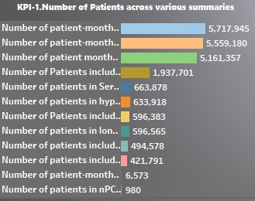
KPI – 1 Number of Patients across various summaries
visualiation

Slide 7
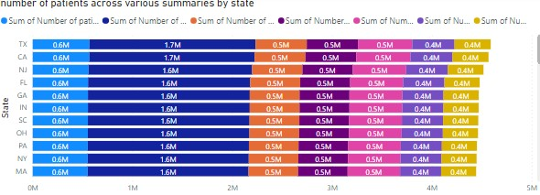
Kpi-1.number of patients across various summaries by state

Slide 8
INSIGHTS
KPI – 1 Number of Patients across various summaries
Chain Organizations with Higher Number of Patients in Various summaries have more No of Dialysis Stations.
California, Texas, Florida and New York are the States with Highest number of patients and so more Healthcare facilities needed.
Survival Summary shows a supremacy in total number of patients and nPCR summary is the least.
According to Patients Hospitalization Summary Satellite Healthcare Central States LLC Is the top Profitable Facility.

Slide 9
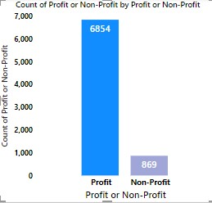
KPI-2 PROFIT VS NON-PROFIT

Slide 10
INSIGHTS
KPI – 2 PROFIT VS NON-PROFIT
Total Count of Profit is 6854 and for Non-Profit is 869.
Main reason for those Chain Organization who has much more Profits is because of High Quality Treatments, also provides high class services to their patients.

Slide 11
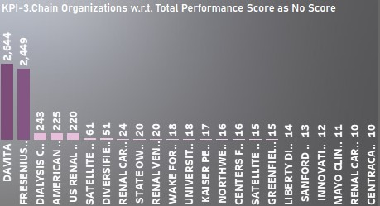
KPI-3 Chain Organizations w.r.t. Total Performance Score as No Score

Slide 12
INSIGHTS
KPI - 3 Chain Organizations w.r.t. Total Performance Score as No Score
The chain organizations to strive for no score as total performance score shows a five star rating indicates that the chain organizations Fresenius Medical Care , Davita .. are
performing well across various metrics such as patient satisfaction, clinical quality and financial performance .
The average of total performance score shows that Atlantis HealthCare Group, Belmont
Court Dialysis Centre has not that good performance across various metrics. So, needs
improvement.

Slide 13
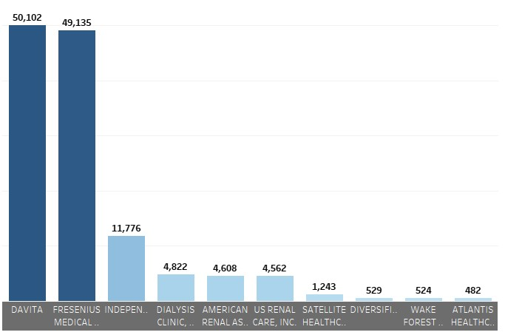
KPI-4 No of dialysis station

Slide 14
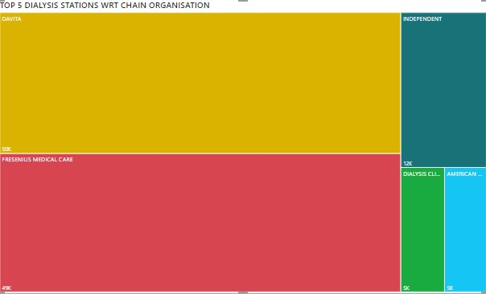
KPI-4. TOP 5 DIALYSIS STATIONS BY CHAIN ORGANISATION

Slide 15
INSIGHTS
KPI – 4 DIALYSIS STATION STATS.
States with more Dialysis Stations have better healthcare and higher earning capacity.
California, Texas, New York, Florida and Georgia are the top-performing states for Dialysis Stations.
Coastal states have higher spending capacity and better healthcare than inland states.
Davita and Fresenius Medical care are the dominant chain organization with a
combined market share of 73%.
Davita and Fresenius have a significant presence in the top 5 states with the most Dialysis Stations, while other organizations operate locally.

Slide 16
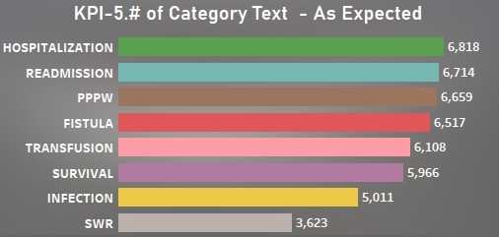
KPI-5 No of category text-As Expect

Slide 17
INSIGHTS
KPI – 5 NO OF CATEGORY TEXT AS EXPECTED
We have Total 8 fields of Category text as Expected.
Patient Hospitalization Category text has a more expected values with 6818.
SWR Category text is the less Expected values with 3623.

Slide 18
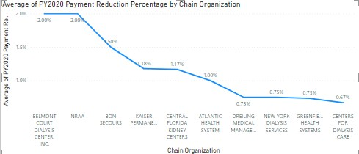
KPI – 6 AVG PAYMENT REDUCTION RATE

Slide 19
INSIGHTS
KPI -6 Avg payment reduction of chain organization
If a chain organization fails to meet or exceed the total performance score, it may receive a payment reduction of up to 2%.
Here NRAA & Belmont court dialysis centre INC have average payment reduction 2% implies they fails to meet their total performance score. This indicates that these chain organization has to focus on various metrics to enhance performance score.

Slide 20
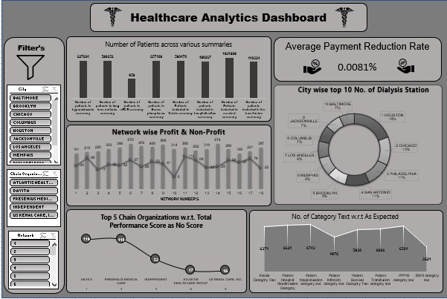
EXCEL MODULE

Slide 21
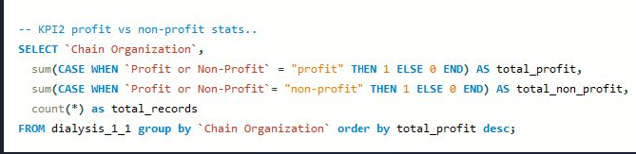
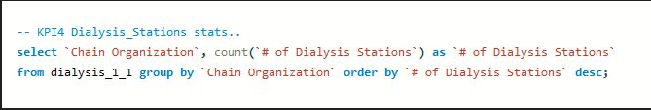
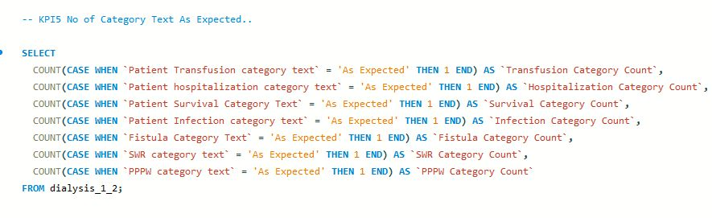
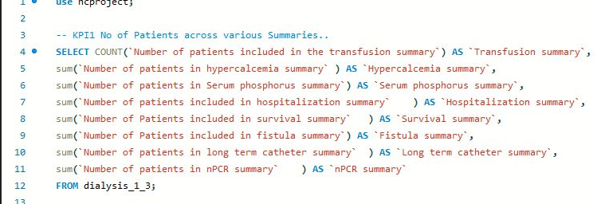
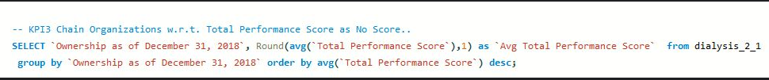
SQL MODULE

Slide 22
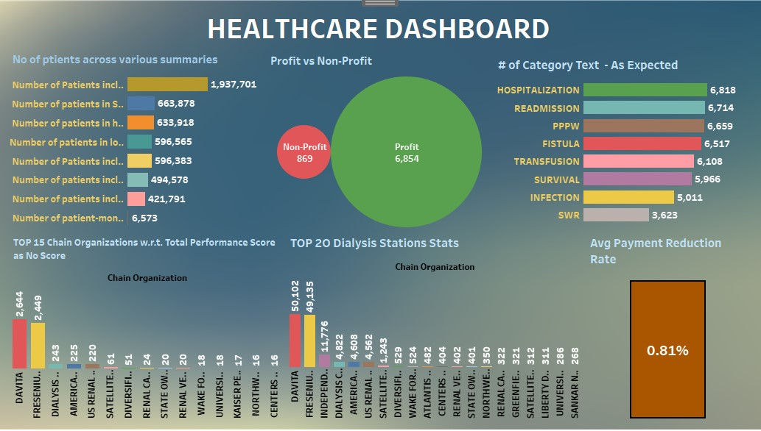
TABLEAU MODULE

Slide 23
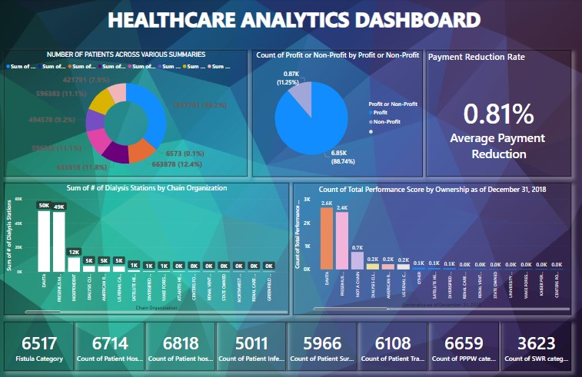
POWER BI MODULE

Slide 24
Summary
KPI 1: Patients: California, Texas, Florida, and New York have the highest number of patients, and Chain Organizations with more patients have more Dialysis Stations.
KPI 2: Profit vs Non-Profit: Davita has the highest number of both Profit and Non-profit chains, and organizations with more profits provide higher quality treatments and services.
KPI 3:Total Performance Score: Fresenius Medical Care, Davita are the leading chain organizations with a five-star rating in patient satisfaction, clinical quality, and financial performance, while Atlantis HealthCare Group and Belmont Court Dialysis Centre need improvement.

Slide 25
Summary
KPI 4: Dialysis Stations: California, Texas, New York, Florida, and Georgia are the top-performing states for Dialysis Stations, and Davita and Fresenius Medical Care are the dominant chain organizations.
KPI 5: Category Text: Patient Hospitalization Category Text has the highest expected values, while SWR Category Text has the least expected values.
KPI 6: Payment Reduction: Chain organizations with no payment reduction, such as Davita and Fresenius Medical Care, have a high-performance score, while Texas, California, Florida, and Georgia have more payment reductions

Slide 26
Conclusion
The states of California, Texas, Florida, and New York have the highest number of patients and Dialysis Stations, indicating a need for more healthcare policies.
Davita and Fresenius Medical Care are the dominant chain organizations providing high- quality treatments and services.
Organizations with higher profits perform better, and those with no payment reductions, like Davita and Fresenius Medical Care, have a high-performance score.
Atlantis HealthCare Group and Belmont Court Dialysis Centre need improvement in their overall performance in all areas

